Slide 1
BIG DATA

Slide 2
OVERVIEW
INTRODUCTION
TYPES OF BIG DATA
PROBLEM STATEMENT
BIG DATA TO BIG VALUE
VIEW OF BIG DATA
3Vs OF BIG DATA
4Vs OF BIG DATA
PROS & CONS
HADOOP
CONCLUSION

Slide 3
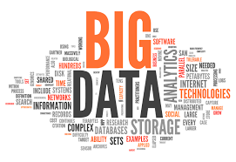
INTRODUCTION
WHAT IS BIGDATA?
'Big Data' is a term used to describe collection of data that is huge in size and yet growing exponentially with time. In short, such a data is so large and complex that none of the traditional data management tools are able to store it or process it efficiently.

Slide 4
TYPES OF BIG DATA
Structured Data Ex: SQL database in table with rows and columns.
Semi structured Data Ex: CSV but XML and JSON documents are semi structured documents
Unstructured Data Ex: e-mail messages, word processing documents, videos, photos, audio files, presentations, webpages and many other

Slide 5

PROBLEM STATEMENT
Large number of products are available on online
Searching for required products on e-commerce website is very difficult

Slide 6

Big Data EveryWhere!
Lots of data is being collected and warehoused
Web data, e-commerce
purchases at department/ grocery stores
Bank/Credit Card transactions
Social Network

Slide 7

How much data?
Google processes 20 PB a day (2008)
Wayback Machine has 3 PB + 100 TB/month (3/2009)
Facebook has 2.5 PB of user data + 15 TB/day (4/2009)
eBay has 6.5 PB of user data + 50 TB/day (5/2009)
CERN’s Large Hydron Collider (LHC) generates 15 PB a year
640K ought to be enough for anybody.

Slide 8
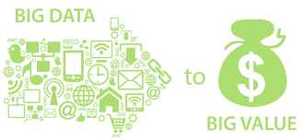
BIG DATA TO BIG VALUE

Slide 9
Why is “Big Data” a “Big Value”?
Government
Obama administration announced “big data” initiative
Many different big data programs launched
Private Sector
Walmart handles more than 1 million customer transactions every hour, which is imported into databases estimated to contain more than 2.5 petabytes of data
Facebook handles 40 billion photos from its user base.
Falcon Credit Card Fraud Detection System protects 2.1 billion active accounts world-wide
Science
Large Synoptic Survey Telescope will generate 140 Terabyte of data every 5 days.
Biomedical computation like decoding human Genome & personalized medicine
Social science revolution……

Slide 10
Computational View of Big Data
Data Visualization
Data Access
Data Analysis
Data Understanding
Data Integration
Formatting, Cleaning
Storage
Data

Slide 11
Big Data & Related Topics/Courses
CS19
Human-Computer Interaction
Data Visualization
Databases
Information Retrieval
Machine Learning
Data Access
Data Analysis
Speech Recognition
Computer Vision
Data Mining
Data Understanding
Data Integration
Natural Language Processing
Data Warehousing
Formatting, Cleaning
Many Applications!
Signal Processing
Storage
Data
Information Theory

Slide 12
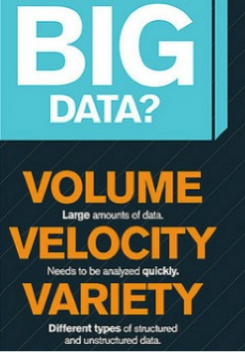
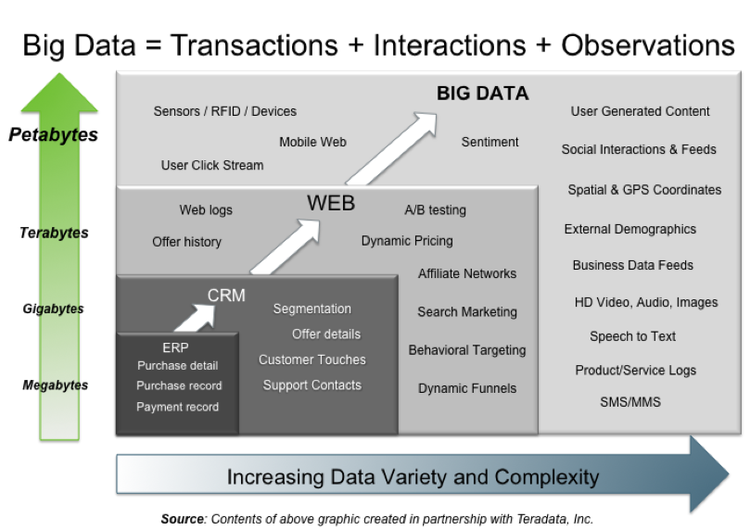
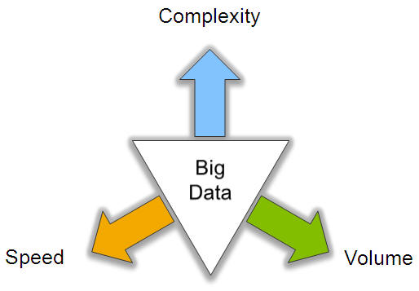
Big Data: 3V’s
3Vs (volume, variety and velocity) are three defining properties or dimensions of big data. Volume refers to the amount of data, variety refers to the number of types of data and velocity refers to the speed of data processing.

Slide 13
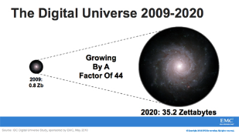
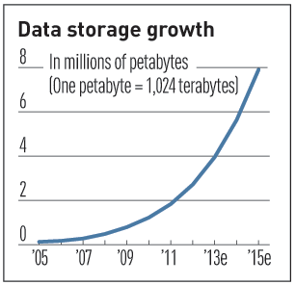

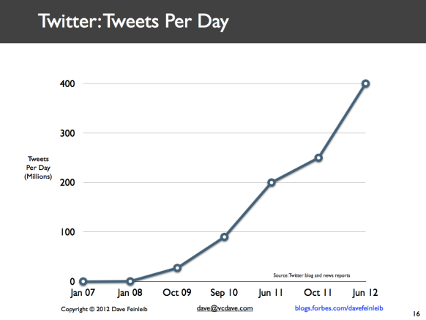
Volume (Scale)
Data Volume
44x increase from 2009 2020
From 0.8 zettabytes to 35zb
Data volume is increasing exponentially
Exponential increase in collected/generated data

Slide 14
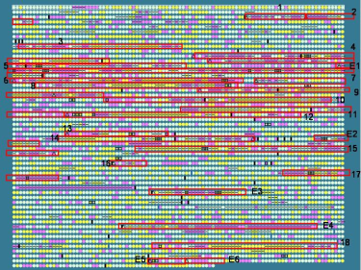

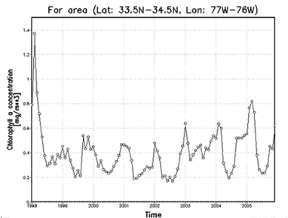

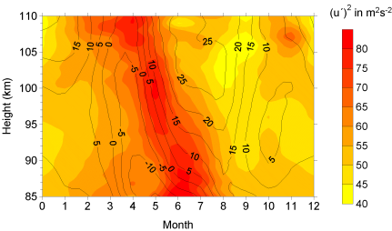

Variety (Complexity)
Relational Data (Tables/Transaction/Legacy Data)
Text Data (Web)
Semi-structured Data (XML)
Graph Data
Social Network, Semantic Web (RDF), …
Streaming Data
You can only scan the data once
A single application can be generating/collecting many types of data
Big Public Data (online, weather, finance, etc)
To extract knowledge➔ all these types of data need to linked together

Slide 15

















A Single View to the Customer
Social Media
Banking
Finance
Gaming
Our
Known
History
Customer
Entertain
Purchase

Slide 16

Velocity (Speed)
Data is begin generated fast and need to be processed fast
Online Data Analytics
Late decisions ➔ missing opportunities
Examples
E-Promotions: Based on your current location, your purchase history, what you like ➔ send promotions right now for store next to you
Healthcare monitoring: sensors monitoring your activities and body ➔ any abnormal measurements require immediate reaction

Slide 17
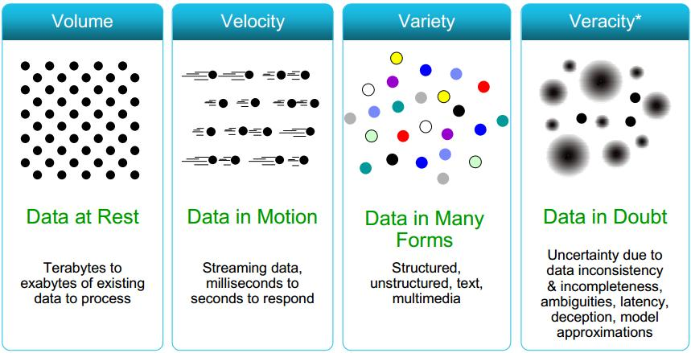
Some Make it 4V’s

Slide 18
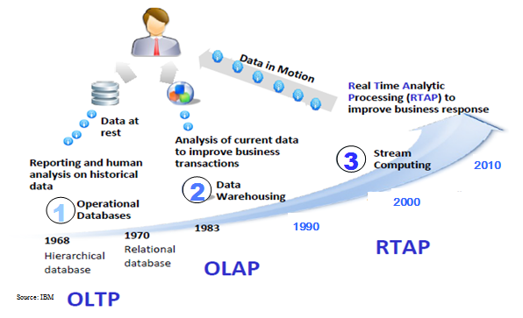
Harnessing Big Data
OLTP: Online Transaction Processing (DBMSs)
OLAP: Online Analytical Processing (Data Warehousing)
RTAP: Real-Time Analytics Processing (Big Data Architecture & technology)

Slide 19
The Evolution of Business Intelligence
Interactive Business Intelligence &
In-memory RDBMS
QliqView, Tableau, HANA
Big Data:
Real Time &
Single View
Graph Databases
Scale
Speed
BI Reporting
OLAP &
Dataware house
Business Objects, SAS, Informatica, Cognos other SQL Reporting Tools
Big Data:
Batch Processing &
Distributed Data Store
Hadoop/Spark; HBase/Cassandra
Speed
Scale
1990’s
2000’s
2010’s

Slide 20
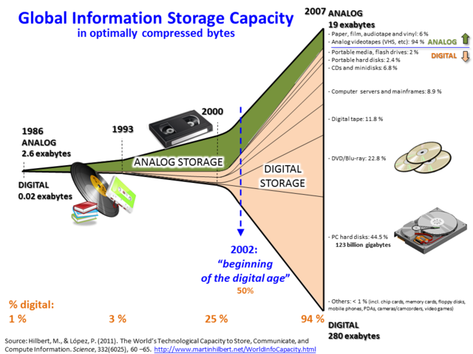
Storage Capacity

Slide 21
PROS & CONS
Pros
It allows businesses to detect errors and fraud quickly.
Real-time analysis allows businesses to develop more effective strategies towards competitors in less time.
data collected is valuable and offers businesses a chance to improve profits and customer service.
Cons
Next, real-time big data demands the ability to conduct sophisticated analyses.
Hackers can easily hack the data.
Civil liberties advocates have attacked the use of big data from license plate scanners and drones.
To overcome these cons by using Hadoop frame work.

Slide 22
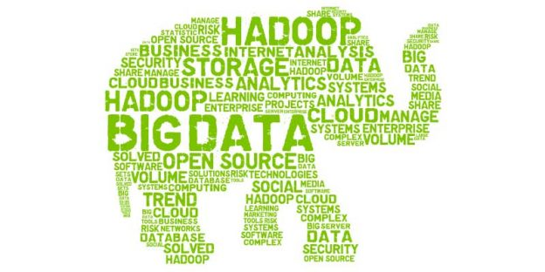
HADOOP Hadoop is an open source distributed processing framework that manages data processing and storage for big data applications running in clustered systems.
WHY HADOOP?
HDFS
MAPREDUCE

Slide 23

HDFS
DISTRIBUTED FILE SYSTEM USED TO RUN ON COMMODITY HARDWAARE

Slide 24
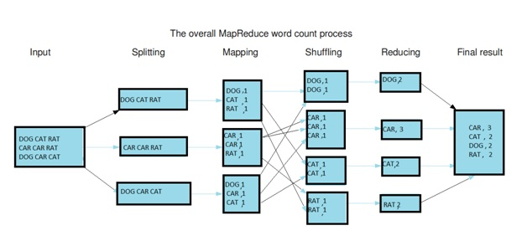
MAPREDUCE

Slide 25
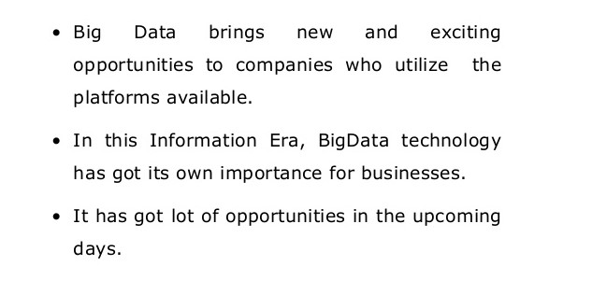
CONCLUSION

Slide 26
References:
1. "The World's Technological Capacity to Store, Communicate, and Compute Information“ MartinHilbert.net. Retrieved 13 April 2016.
2. Laney, Doug (2001). "3D data management: Controlling data volume, velocity and variety". META Group Research Note. 6 (70).
3. Goes, Paulo B. (2014). "Design science research in top information systems journals". MIS Quarterly: Management Information Systems. 38 (1): –.
4. Marr, Bernard (6 March 2014). "Big Data: The 5 Vs Everyone Must Know".
5. boyd, dana; Crawford, Kate (21 September 2011). "Six Provocations for Big Data". Social Science Research Network: A Decade in Internet Time: Symposium on the Dynamics of the Internet and Society. doi:10.2139/ssrn.1926431.
6.“Data, data everywhere". The Economist. 25 February 2010. Retrieved 9 December 2012.
7. "Community cleverness required". Nature. 455 (7209): 1. 4 September 2008. Bibcode:2008Natur.455....1.. doi:10.1038/455001a. PMID 18769385.

Slide 27
Thank You…

Slide 28
Any Queries..???

